Slide 1

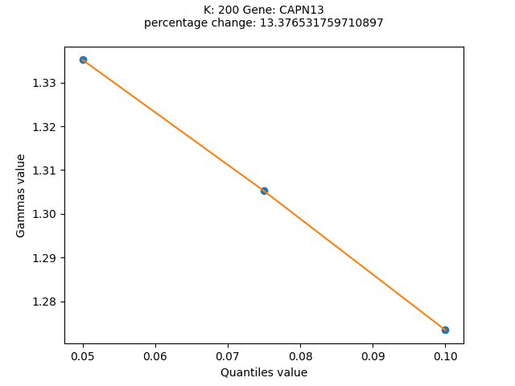
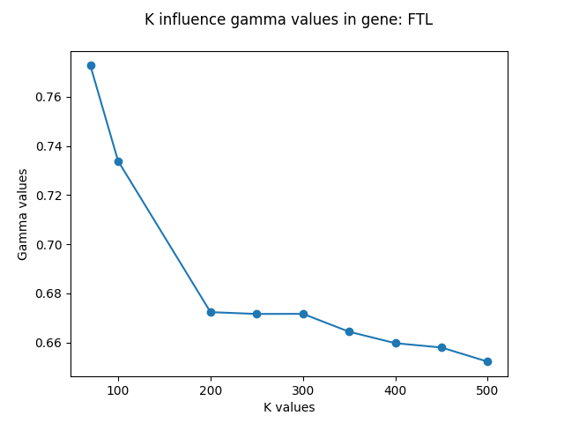
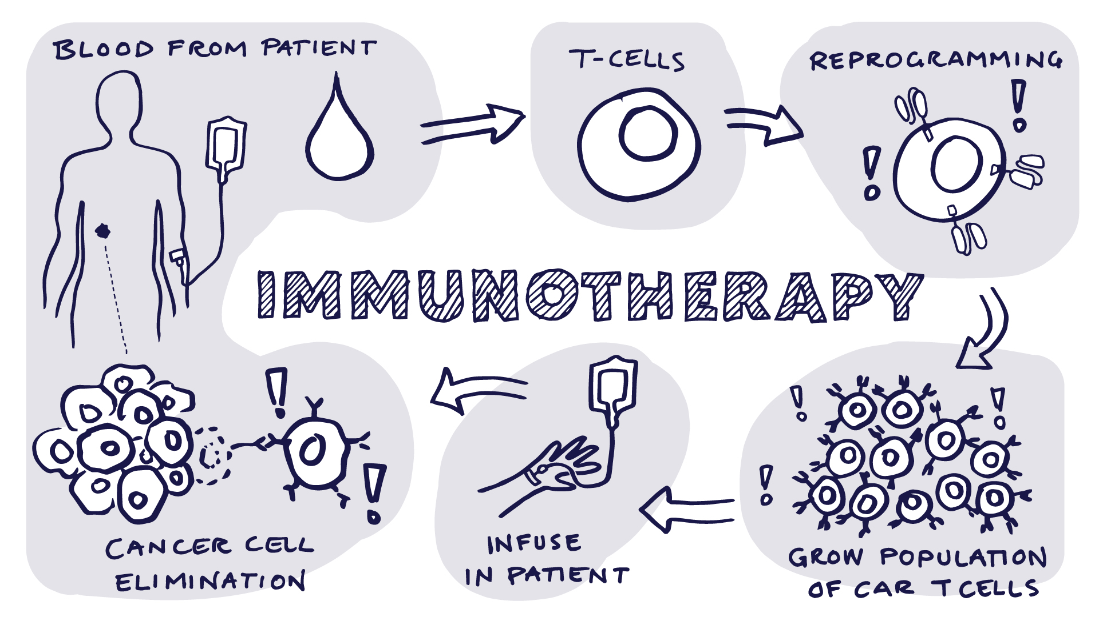
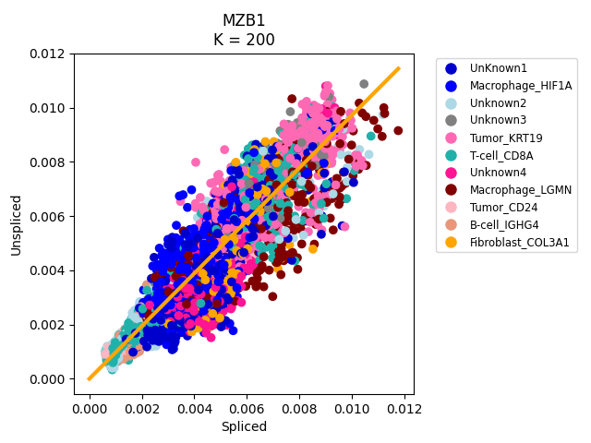
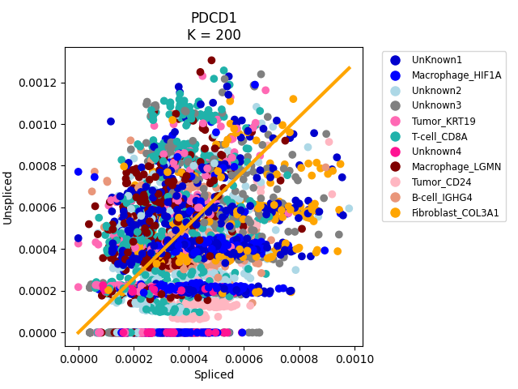
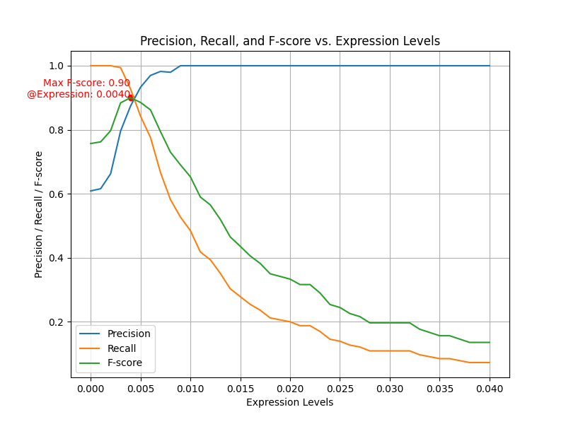
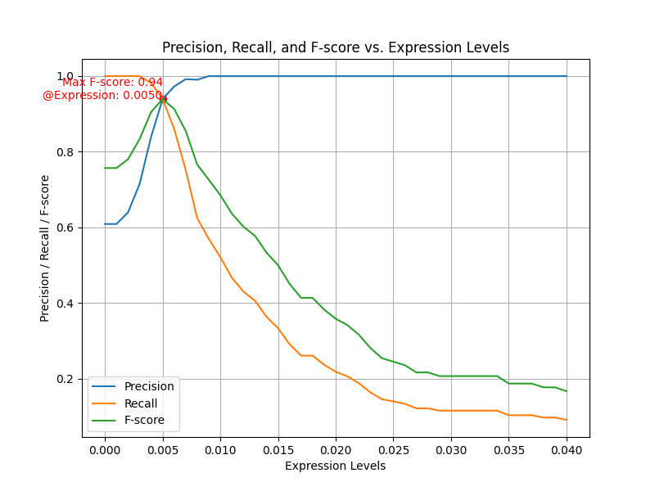
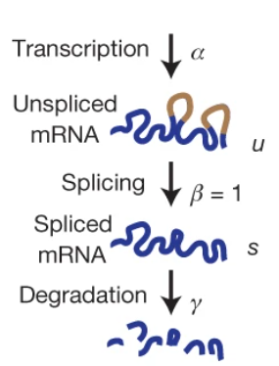
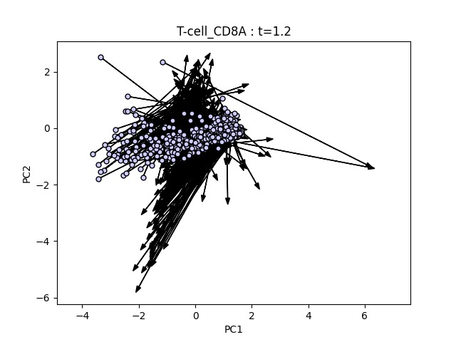
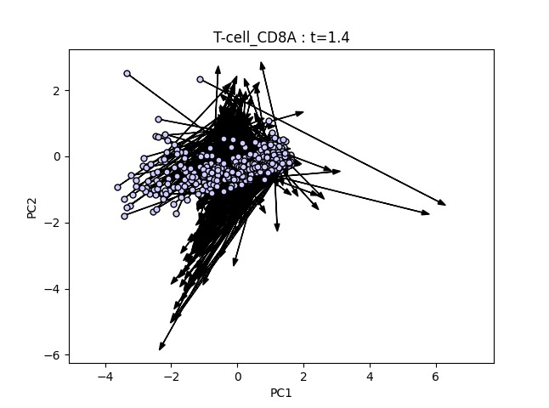
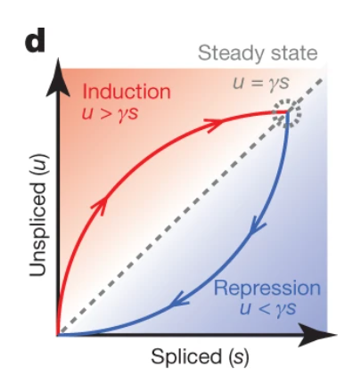
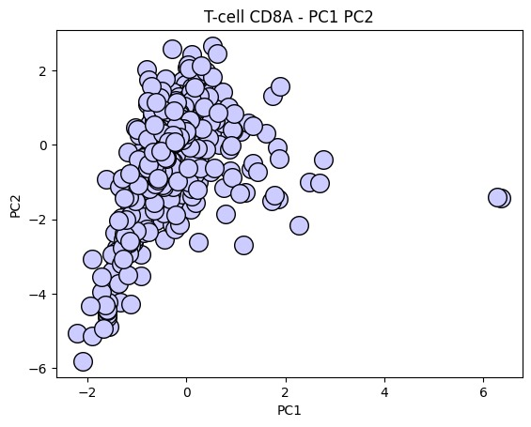
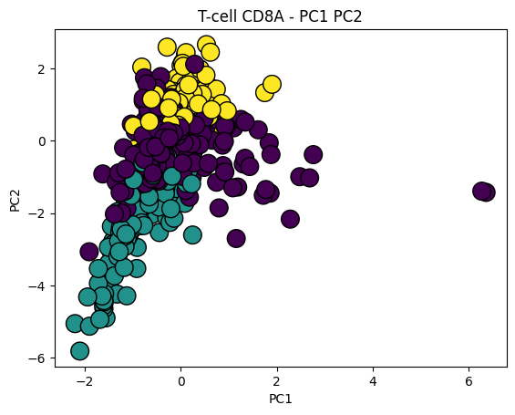
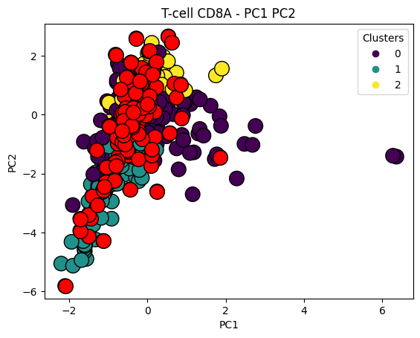
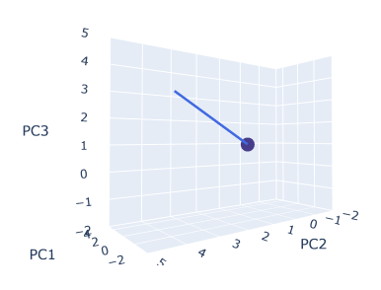
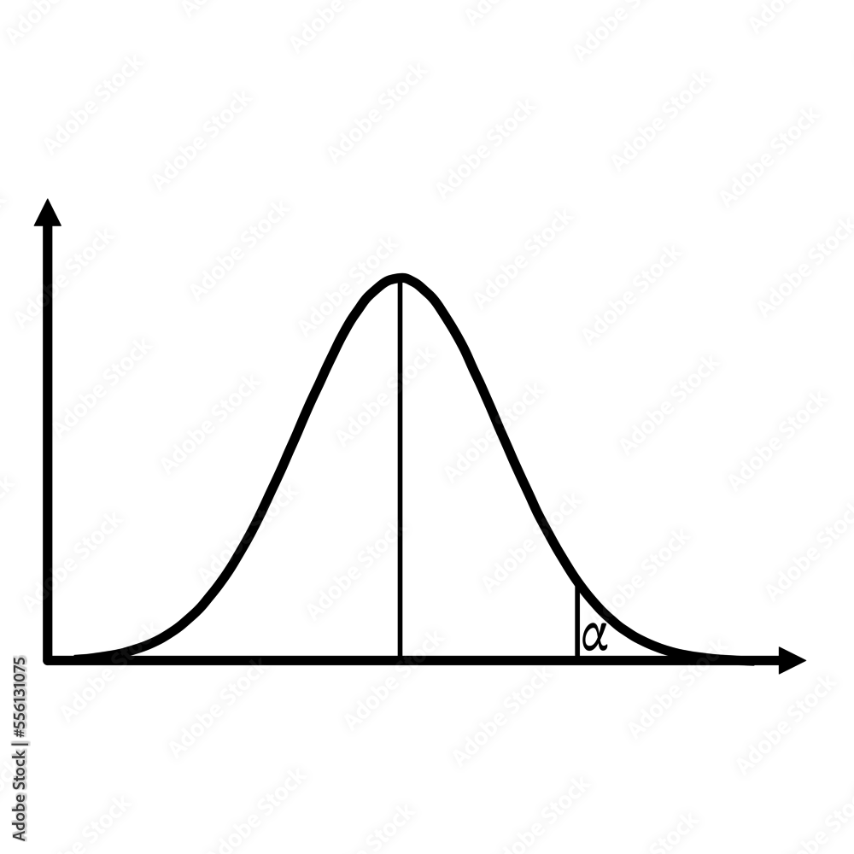

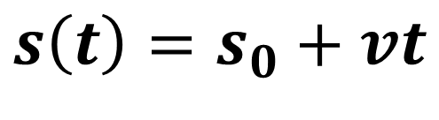


Under the supervision of: Prof. Shahar Alon and Tal Goldberg
תשפ"ד 2024
Prediction of future gene expression in cells using computational modelling
Adi Shrem and Dotan Sadka
Motivation
Immunotherapy engages the immune system against cancer tumors. However, predicting whether the treatment will work or not remains a challenge. We aim to use RNA velocity to detect interactions between cells, specifically between immune cells and cancer cells, by linking RNA velocity which calculate the future state of the cells to the physical locations of cells in the tissue measured using Expansion Sequencing (ExSeq), Dr. Alon's lab solution to precise in situ transcriptomics – revealing RNA location inside and outside the nucleus. Combining the two methods might hopefully estimate interaction between immune cells and tumor cells.
Hyper parameters
In order to optimize the process, choosing the right hyper parameters is key for good results.
One of the 20 highest results in the percentage change of quantile values
Convergence around K=200 neighbors
Ground Truth Gene
Filtered Gene
RNA Velocity
$v$ $=\frac{ds}{dt}=u_{0}−γs_{0}$
γ = degradation, the ratio between unspliced and spliced mRNA for each gene.
F-score: 0.90, Expression: 0.004
F-score: 0.94, Expression: 0.005
Future gene expression vector, PC1, PC2, t=1.2
Future gene expression vector, PC1, PC2, t=1.4
Gene expression in cells is highly dynamic, with RNA levels in the nucleus and cytoplasm continuously changing. We hypothesize that cells interaction can trigger gene induction or repression.
Results – proximity of T-cells to tumor cells
future state of CD8A gene in T-cells, the proximity to tumor cells, might indicate interaction between T-cells and tumor cells.
Gene Expression Dynamics
RNA velocity of single cells by La Manno, Fig.1.d
Projecting cell future gene expression in PCA space.
Cluster 0
Cluster 1
Cluster 2
Heterogeneous population
22%
26%
S(t)
15%
19%
$$s\left(t\right)=s_{0}+vt$$
$$S_{0}$$
P value < 0.05

